Slide 1
ECII/ECSI 3206: Artificial Intelligence [and expert systems] Topic 9: Computer Vision and Robotics
By: Edgar Otieno

Slide 2
COMPUTER VISION
Computer vision is a branch of science that is concerned with processing images to extract, analyze, and understand useful information from a single image or image sequence .
It aims at simulating the human visual system.
It uses various machine learning and deep learning algorithms to analyze images for scenes, objects, faces, and other content in videos, photos, and pictures in general.

Slide 3
The MINST data set is a large database of hand-written digits that is commonly used for training various image processing systems. The database is also widely used for training and testing in the field of machine learning

Slide 4
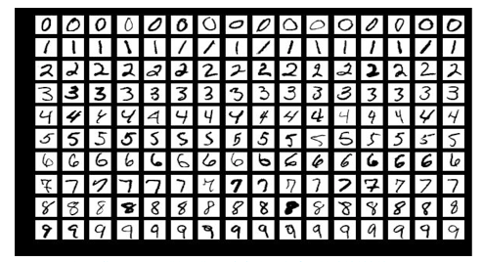
Sample

Slide 5
Computer vision applications
Manufacturing: Use images from a manufacturing setting to make sure that products are being positioned correctly on an assembly line, or ensure product quality by identifying defective parts on the production line instead of by using manual validation.
Visual auditing: Look for visual compliance or deterioration in a fleet of trucks, planes, or windmills, etc.. in the field. Train custom models to understand what defects look like.
Insurance: Rapidly process claims by using images to classify claims into different categories.
Social listening: Use images from your product line or your logos to track buzz about your company on social media.
Medical image processing: Using images for diagnosing patients, such as the detection of tumors.
Automotive industry: There are many applications for CV in cars. For example, while parking a car, a camera can detect objects and warn the driver when they get too close to them.
Public safety: Automated license-plate reading.

Slide 6
Computer Vision Tasks
A CV task represents a well-defined problem in CV that can be solved to a certain extent or accuracy by using one method or another.
Object detection and recognition deals with locating and detecting certain patterns within the image. For example, detecting red eyes when taking photos in certain conditions. Other applications include face detection and face recognition or tracking a person in a video.

Slide 7
Content-based image retrieval or “query-by image content” (QBIC) is the retrieval of images from a database by using an image as a query. "Content-based" refers to actual feature contents of the image like colors, shapes, and textures. Not using image metadata (keywords, tags, or descriptions)
Optical character recognition (OCR): Scan papers and hand-written forms, identify the characters in them, and transform them into digital format (strings).

Slide 8
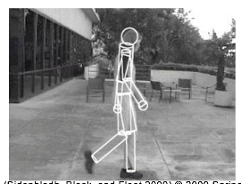
Object tracking: Following the position changes of a target object from one frame to another within an image sequence or video.

Slide 9
Image restoration: Fixing and restoring images that are corrupted by noise, such as motion blur, to their default state.
Scene reconstruction: Creation of 3D model by supplying the system with multiple 2D images from different views. The computer constructs a 3D model based on those images.

Slide 10
Computer Vision Tools
OpenCV: An open-source library that can be used to perform most CV tasks that are required on any language. It has C++, Python, Java, and MATLAB interfaces.
Microsoft Vision API: Specialized in OCR and analyzing videos.
IBM Watson Visual Recognition: This service is available on IBM Cloud. A set of built-in classes provides highly accurate results without training.

Slide 11
Computer Vision Use Cases
Facial recognition: We use facial recognition daily.
Taking a photo and applying effects by using your smartphone.
Tagging friends on social media.
Augmented reality (AR) :is the manipulation and addition of a system-generated image (3D or 2D) as an overlay of a user’s view. Examples include Google Glass, emoji filters in some mobile apps, and Pokémon Go. Mobile shopping applications will give in-store shoppers instant product details and promotions through their mobile devices.

Slide 12
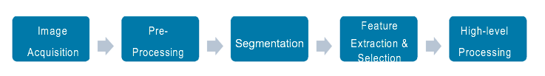
Computer vision pipeline
The steps and functions that are included are highly dependent on the application.
Below is a conventional visual pattern recognition pipeline

Slide 13
ROBOTICS
Robotics is a branch of AI, which is composed of Electrical Engineering, Mechanical Engineering, and Computer Science for designing, construction, and application of robots.
Robots are the artificial agents acting in real world environment. Robots are multifunctional, re-programmable, automatic industrial machine designed for replacing human in hazardous work.
Robots are aimed at manipulating the objects by perceiving, picking, moving, modifying the physical properties of object, destroying it, or to have an effect thereby freeing manpower from doing repetitive functions without getting bored, distracted, or exhausted.

Slide 14
Aspects of Robotics
The robots have electrical components for providing power and control the machinery.
They have mechanical construction, shape, or form designed to accomplish a particular task.
It contains some type of computer program that determines what, when and how a robot does something.

Slide 15
The three laws of Robotics
Issac Asimov also proposed his three "Laws of Robotics", and he later added a "zeroth law"
Zeroth Law - A robot is not allowed to injured humanity, or, through inaction it allows humanity to come to harm.
First Law - A robot can not injure a human being, or, through inaction it allows a human being to come to harm, unless it would violate the higher order law.
Second Law - A robot should follow the orders given it by human beings, except when such orders give by humans would conflict with a higher order law.
Third Law - A robot is allowed to protect its own existence as long as such protection would not conflict with a higher order law.

Slide 16
Components of Robot
Power Supply - The working power to the robot is provided by batteries, hydraulic, solar power, or pneumatic power sources.
Actuators - Actuators are the energy conversion device used inside a robot. The major function of actuators is to convert energy into movement.
Electric motors (DC/AC)- Motors are electromechanical component used for converting electrical energy into its equivalent mechanical energy. In robots motors are used for providing rotational movement.
Sensors - Sensors provide real time information on the task environment. Robots are equipped with tactile sensor it imitates the mechanical properties of touch receptors of human fingerprints and a vision sensor is used for computing the depth in the environment.
Controller - Controller is a part of robot that coordinates all motion of the mechanical system. It also receives an input from immediate environment through various sensors. The heart of robot's controller is a microprocessor linked with the input/output and monitoring device. The command issued by the controller activates the motion control mechanism, consisting of various controller, actuators and amplifier.

Slide 17
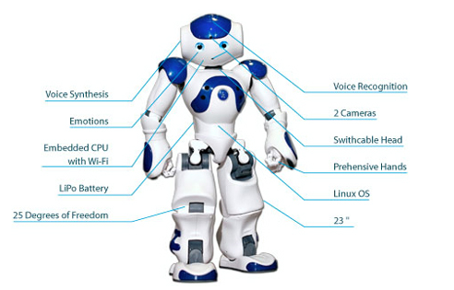
Sample Robot

Slide 18
Robot Locomotion
Locomotion is the method of moving from one place to another. The mechanism that makes a robot capable of moving in its environment is called as robot locomotion.
There are many types of locomotion's:-
Wheeled
Legged
Tracked slip/skid
Combination of legged and wheeled locomotion

Slide 19
Types of Robots
1) Mobile Robots
Mobile robots are able to move from one location to another location using locomotion. It is an automatic machine that is capable of navigating an uncontrolled environment without any requirement of physical and electromechanical guidance devices. Mobile Robots are of two types:
(a) Rolling robots - Rolling robots require wheels to move around. They can easily and quickly search. But they are only useful in flat areas.
(b) Walking robots - Robots with legs are usually used in condition where the terrain is rocky. Most walking robots have at least 4 legs.

Slide 20
2) Industrial Robots
Industrial robots perform same tasks repeatedly without ever moving. These robots are working in industries in which there is requirement of performing dull and repeated tasks suitable for robot.
An industrial robot never tired, it will perform their works day and night without ever complaining.

Slide 21
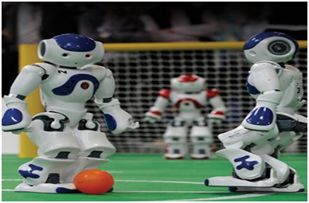
3) Autonomous Robots
Autonomous robots are self-supported. They use a program that provides them the opportunity to decide the action to perform depending on their surroundings.
Using artificial intelligence these robots often learn new behavior. They start with a short routine and adapt this routine to be more successful in a task they perform. Hence, the most successful routine will be repeated.

Slide 22
4) Remote Controlled Robots
Remote controlled robot used for performing complicated and undetermined tasks that autonomous robot cannot perform due to uncertainty of operation.
Complicated tasks are best performed by human beings with real brainpower. Therefore a person can guide a robot by using remote. Using remote controlled operation human can perform dangerous tasks without being at the spot where the tasks are performed.

Slide 23
Types of Robot Sensors
1) Light Sensor
Light sensor is a transducer used for detecting light and creates a voltage difference equivalent to the light intensity fall on a light sensor.
The two main light sensors used in robots are Photovoltaic cells and Photo resistor. Other kind of light sensors like phototransistors, phototubes are rarely used.
The type of light sensors used in robotics are:
Photo resistor - It is a type of resistor used for detecting the light. In photo resistor resistance varies with change in light intensity. The light falls on photo resistor is inversely proportional to the resistance of the photo resistor. Its also called as Light Dependent Resistor (LDR).
Photovoltaic Cells - Photovoltaic cells are energy conversion device used to convert solar radiation into electrical electric energy. It is used if we are planning to build a solar robot.

Slide 24
2) Proximity Sensor
Proximity sensor can detect the presence of nearby object without any physical contact. The working of a proximity sensor is simple. In proximity sensor transmitter transmits an electromagnetic radiation and receiver receives and analyzes the return signal for interruptions. Therefore the amount of light receiver receives by surrounding can be used for detecting the presence of nearby object.
Consider the types of proximity sensors used in robotics are:-
Infrared (IR) Transceivers - In IR sensor LED transmit the beam of IR light and if it find an obstacle then the light is reflected back which is captured by an IR receiver.
Ultrasonic Sensor - In ultrasonic sensors high frequency sound waves is generated by transmitter, the received echo pulse suggests an object interruption.

Slide 25
3) Sound Sensor
Sound sensors are generally a microphone used to detect sound and return a voltage equivalent to the sound level. Using sound sensor a simple robot can be designed to navigate based on the sound receives.
Implementation of sound sensors is not easy as light sensors because it generates a very small voltage difference which will be amplified to generate measurable voltage change.

Slide 26
4) Temperature Sensor
Temperature sensors are used for sensing the change in temperature of the surrounding. It is based on the principle of change in voltage difference for a change in temperature this change in voltage will provide the equivalent temperature value of the surrounding.
Few generally used temperature sensors ICs are TMP35, TMP37, LM34, LM35, etc.

Slide 27
5) Acceleration Sensor
Acceleration sensor is used for measuring acceleration and tilt. An accelerometer is a device used for measuring acceleration.
Accelerometer is comes in different configuration. Always use the one which is most appropriate for your robot. Some factors need to be considered before selecting accelerometer is:
Sensitivity
Bandwidth
Output type: Analog or Digital
Number of Axis: 1,2 or 3

Slide 28
Microcontroller in Robotics
Microcontroller is the advanced version of microprocessors. It contain on chip central processing unit (CPU), Read only memory (ROM), Random access memory (RAM), input/output unit, interrupts controller etc.

Slide 29
Basic components of Microcontroller
Arithmetic and Logic unit (ALU) - ALU inside a microcontroller used to perform the arithmetic and logic operation. It performs the logic operation on the data stored inside a register.
Accumulator -Accumulator is the register inside which the intermediate arithmetic and logical operation data is stored.
Working registers - Registers are the storage device used to store the data inside a microcontroller in different address location.
Program counter - Program counter is used for counting the number of program executed inside a microcontroller.
Stack pointer - Stack pointer act as a pointer to the certain address. It is a register used to store the address of the last program request made by the processor inside a stack.

Slide 30
Clock circuit - Clock circuit is used for generate the clock pulse required as a reference signal for the microcontroller.
Interrupt circuit - Interrupt circuit is used for generating the interrupt signal when the higher priority process required to be served first on basis of priority by microcontroller.
Internal ROM - Internal ROM is read only memory used to store the information in embedded system. It acts as a main memory for storing the instruction and data inside a microcontroller.
I/O ports - I/O ports are used for connecting input devices like sensor, keyboard etc with input ports and output devices like LCD, buzzer etc with output ports available in microcontroller.

Slide 31
Printed Circuit Board[PCB]
Printed circuit board connects electrical components using etched copper pathways and it also provides mechanical strength to the robotic circuit. PCBs are composed of organic and inorganic dielectric materials with many layers.

Slide 32
ARDUINO vs RASPBERRY PI
Raspberry Pi and Arduino are two very popular boards
Arduino is a simple electronics prototyping tool with open-source hardware and software. Arduino is essentially a Microcontroller development board using which you can Blink LEDs, accept inputs from Buttons, read data from Sensors, control Motors and many other “Microcontroller” related tasks.
The most popular Arduino board is the Arduino UNO, which is based on ATmega328P Microcontroller from Atmel (now Microchip). Coming to the software side of Arduino, all Arduino boards can be programmed in C and C++ programming languages using a special software called Arduino IDE.

Slide 33
Overview
Raspberry Pi is a Microprocessor (usually an ARM Cortex A Series) based board that acts as a computer(Single Board Computers).While Arduino is a Microcontroller based development board.
You can connect several peripherals like a Monitor (through HDMI or AV Port), Mouse and Keyboard (through USB), connect to internet (through Ethernet or Wi-Fi), add a Camera (through the dedicated Camera Interface), just like we do to our desktop computer.
Another important thing about Raspberry Pi is, as it is a Linux based Computer, you can develop software using several Programming Languages like C, C++, Python, Java, HTML,

Slide 34
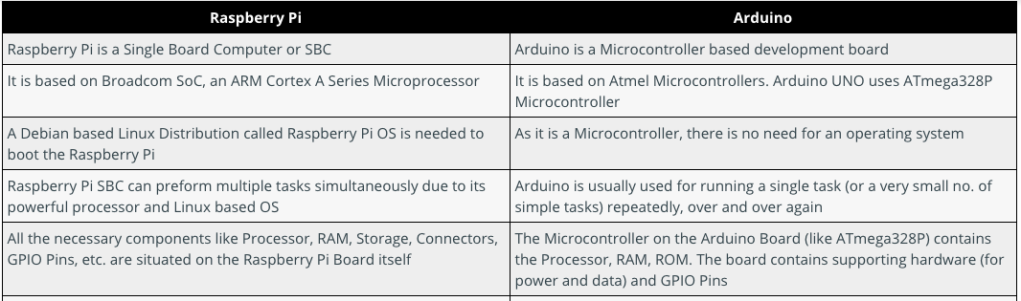
Comparison

Slide 35
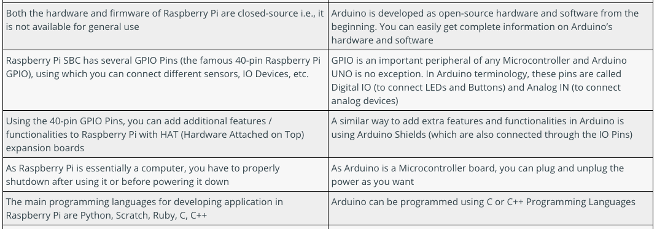
Cont…..

Slide 36
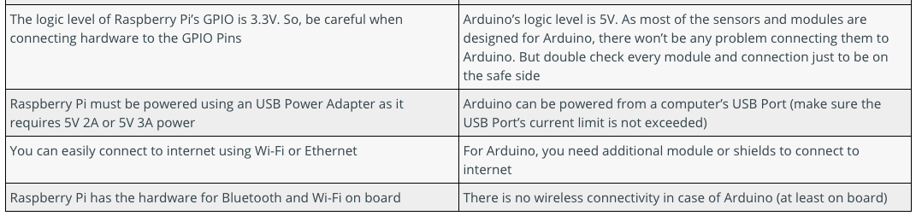
Cont….

Slide 37
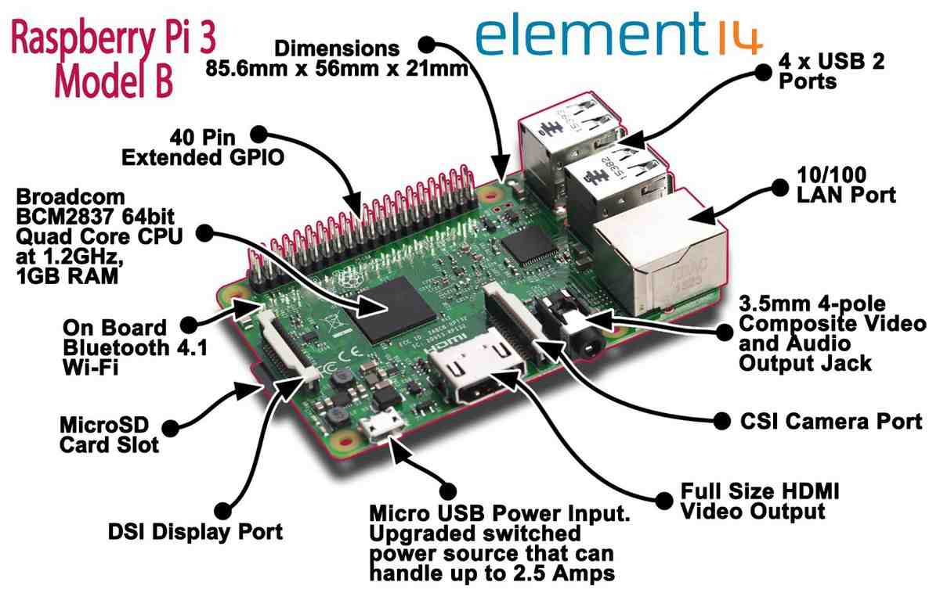
Raspberry Pi

Slide 38
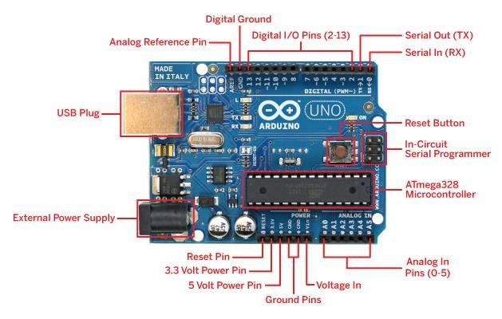
Arduino UNO

Slide 39
